Slide 1

THE COMMON APPLICATION
ALLAN CHERUIYOT.
BRIAN OWEKA OTIENO
ELP 2021
Medicine
Selçuk Üniversitesi, Konya

Slide 2
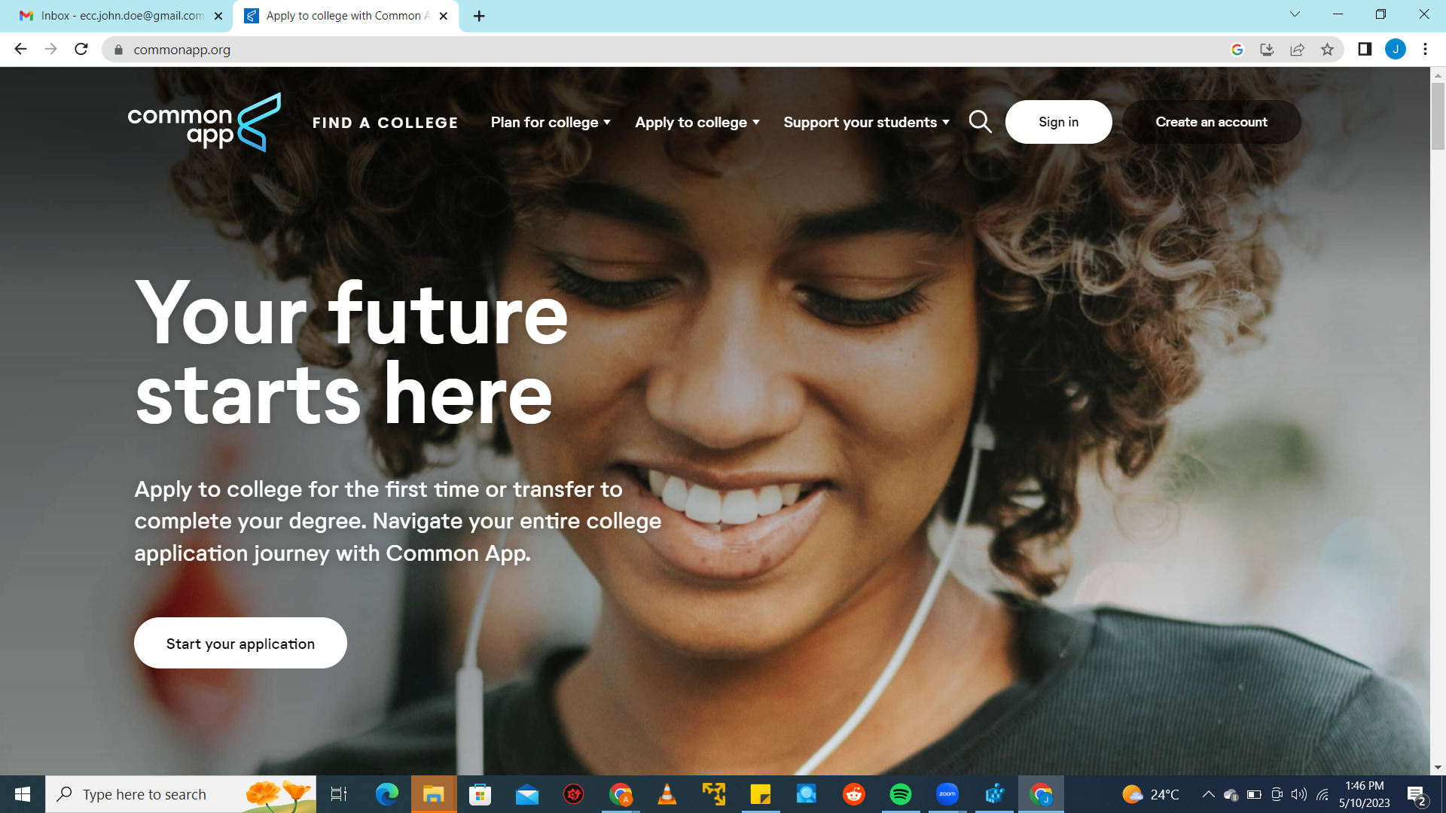
Click here to
create your new
account

Slide 3
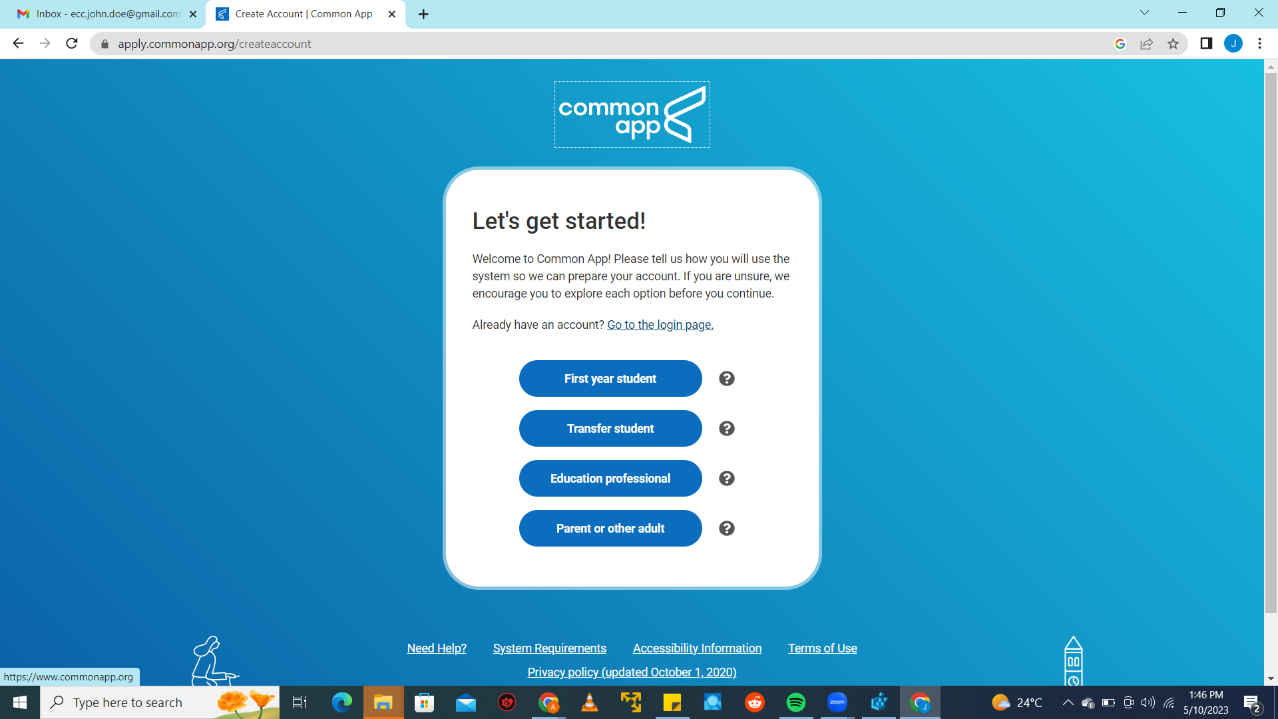
Choose "First Year
Student"

Slide 4
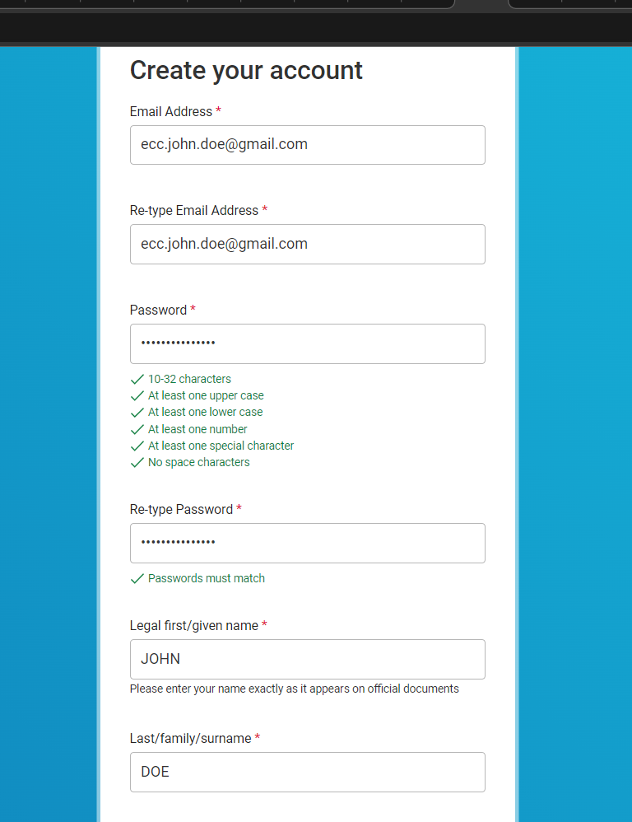
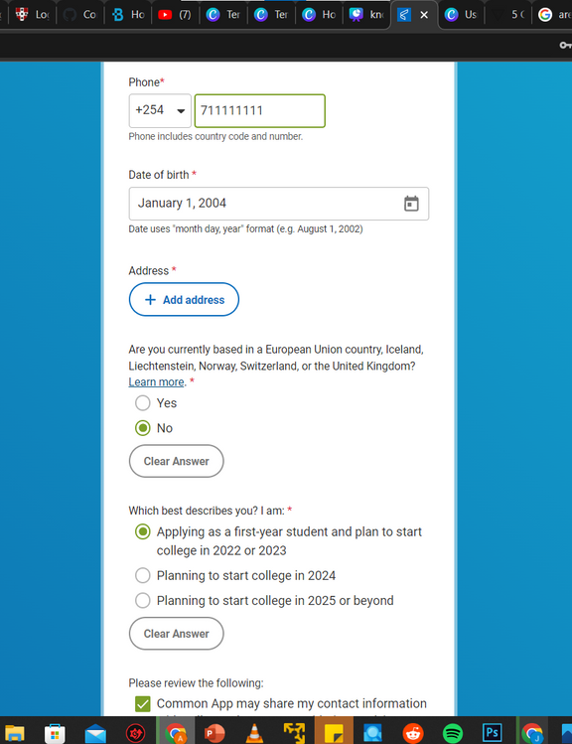


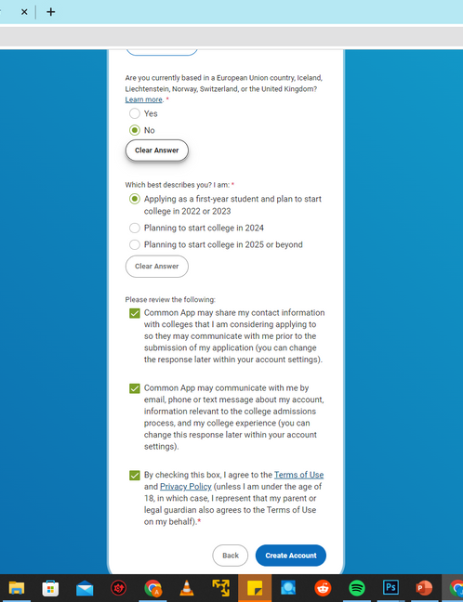
What you will need:
A working email address
A working phone number
Your home address
A Strong Password

Slide 5
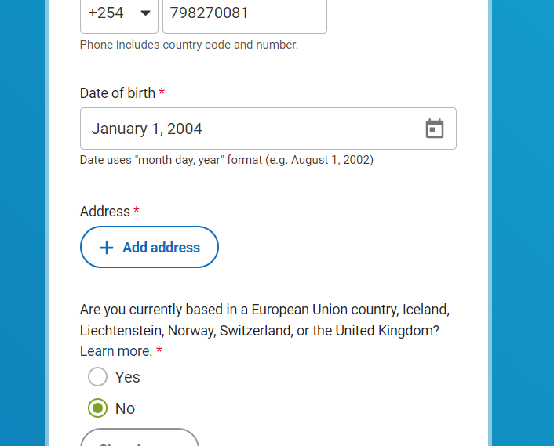
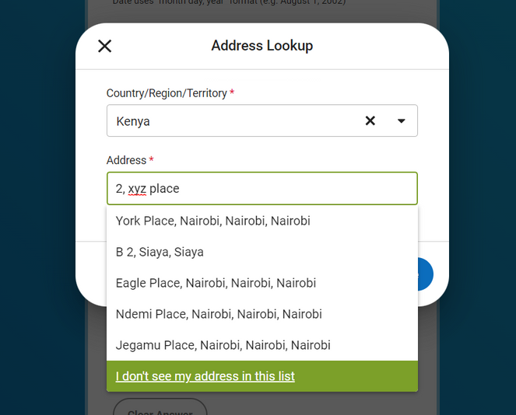
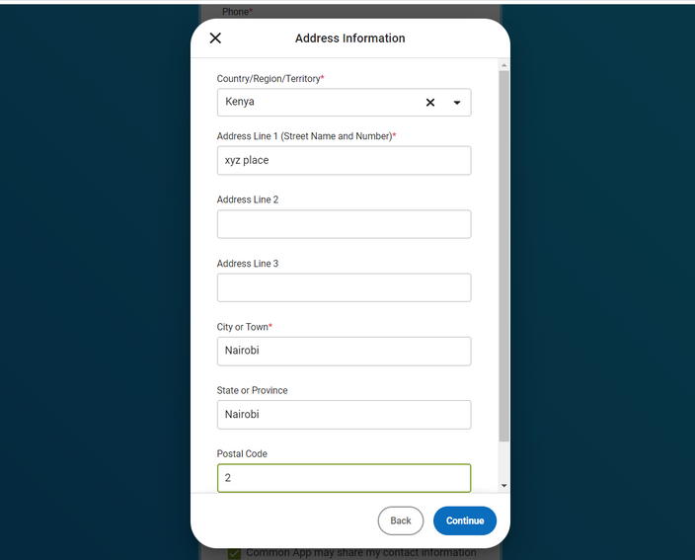

Can't see your address?
Sometimes, your address may not be present in Common App's database. Not to worry. Follow these steps to add your home address.
You can also do this when adding your high school later on.
Steps to add your address
Type your address. If not present in the list, choose "I don't see my address in the list"
Fill in your address details and click "Continue"
Click on "Add address"

Slide 6
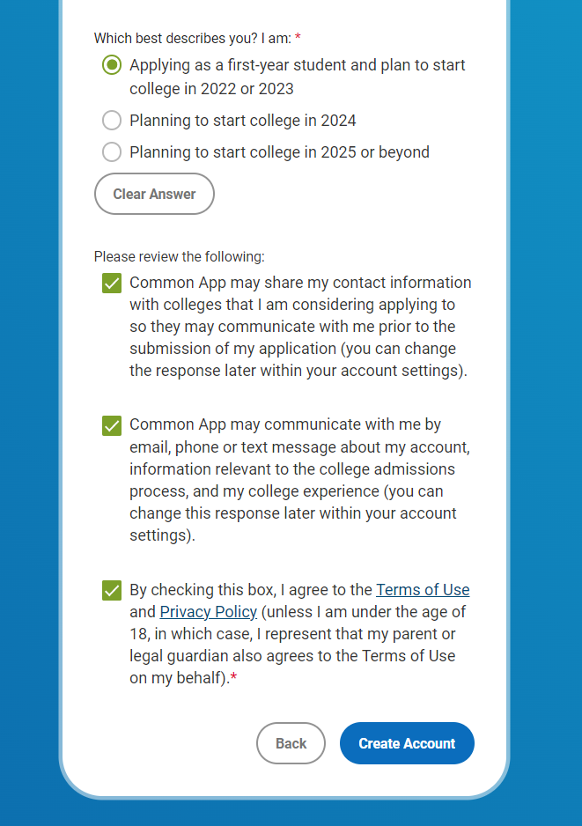


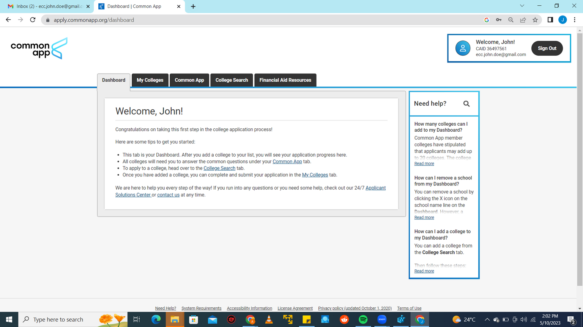

Your Dashboard
Your
Common
App ID
(CAID)
Accept all the Terms and Conditions
and Create your account

Slide 7
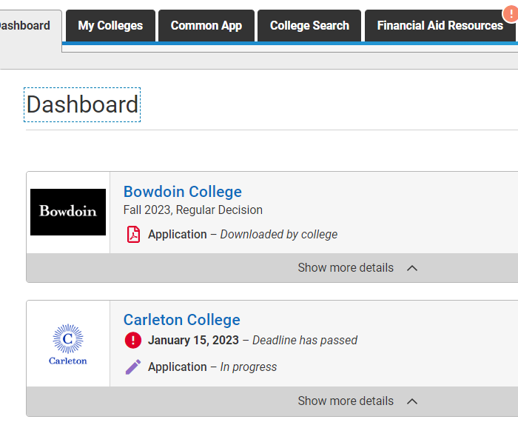
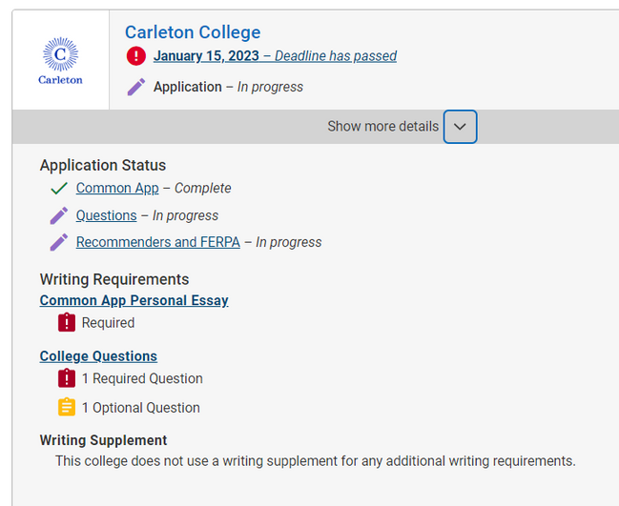
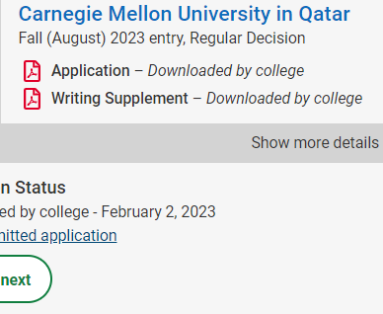
What's the dashboard for?
Navigating the Dashboard
Shows number of days to the deadline of your chosen cycle.
Info on which essays are required.
Number of supplementary essays at a glance.
Lists the colleges you have chosen to apply to.
Shows the status of your submitted application

Slide 8

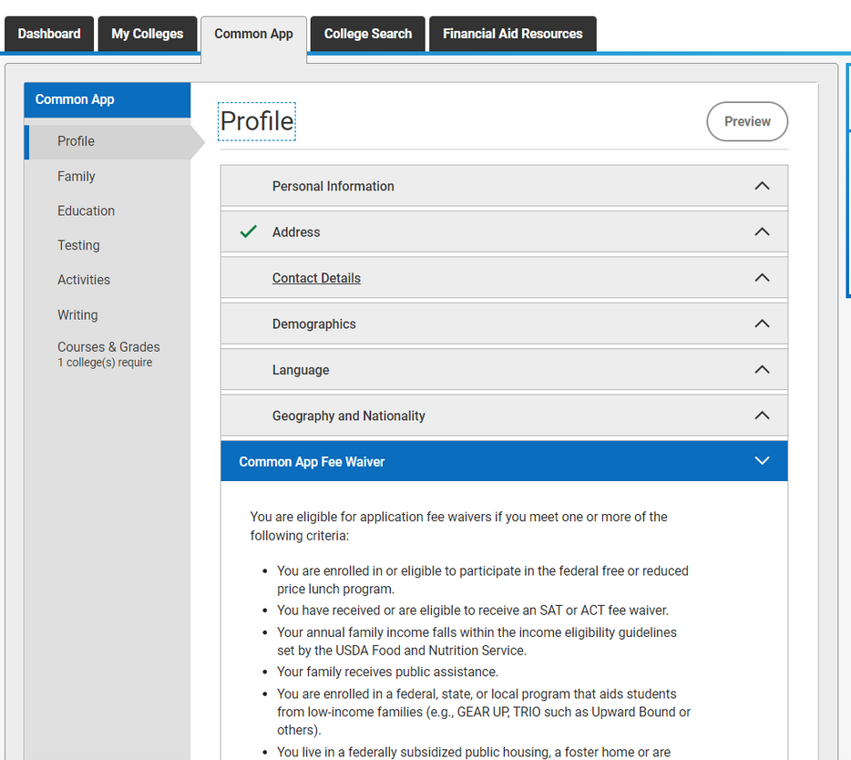

COMMON APP
YOUR
Profile
Fill in personal info like your name, address, contact, languages spoken, demographics e.g. gender, etc.
01
02
Choose "Yes" when asked whether you qualify for a fee waiver. Your counselor will provide a supporting statement.
03
Choose English as your first language
04
Visa to be applied for: F-1 Student Visa

Slide 9
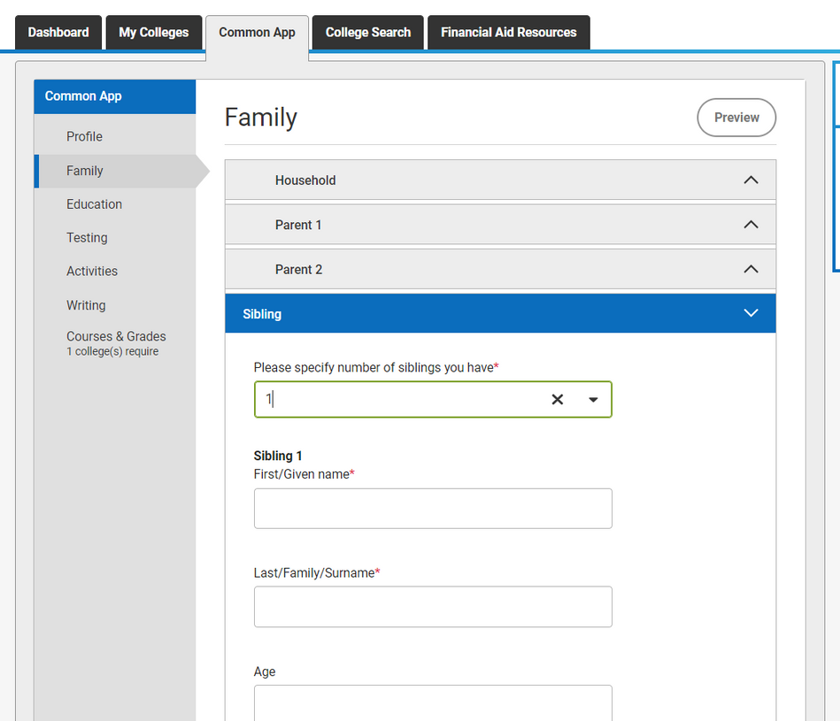
COMMON APP
YOUR
Family
01
Provide info on the size of your household
02
Provide names, occupations and level of education of your parents. Provide names of siblings.
03
If you don't have much info on one or both parents, you can choose "I have limited information about this parent" when filling in the Parent subsection.

Slide 10
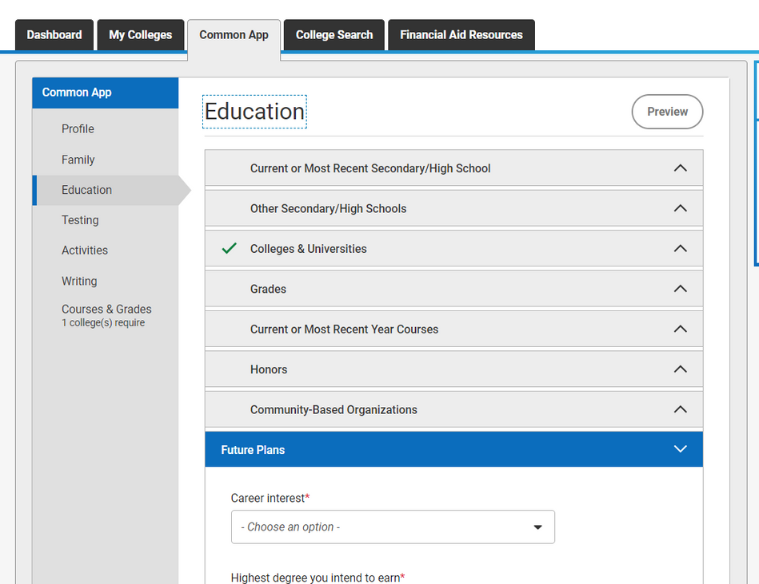
COMMON APP
YOUR
Education
01
Fill in your former high school under "Most recent secondary/high school.
02
Select "Did or will take a gap year and write a 250-word gap year essay.
Indicate any other high schools you attended. You will be required to provide reasons for leaving the school(s).
03
Report class size, rank, and all subjects you took in your last academic year
scheduling system - trimester
course level - regular/standard
03

Slide 11
COMMON APP
YOUR
Education
01
Rank weighting - unweighted
02
Leave out Cumulative GPA, GPA Scale reporting, and GPA weighting.
03
Do not leave the Honors subsection blank
Community-based organizations - Equity Group Foundation.
Fill in Beverly's or Eva's details under Counselor/Advisor/Mentor
04

Slide 12
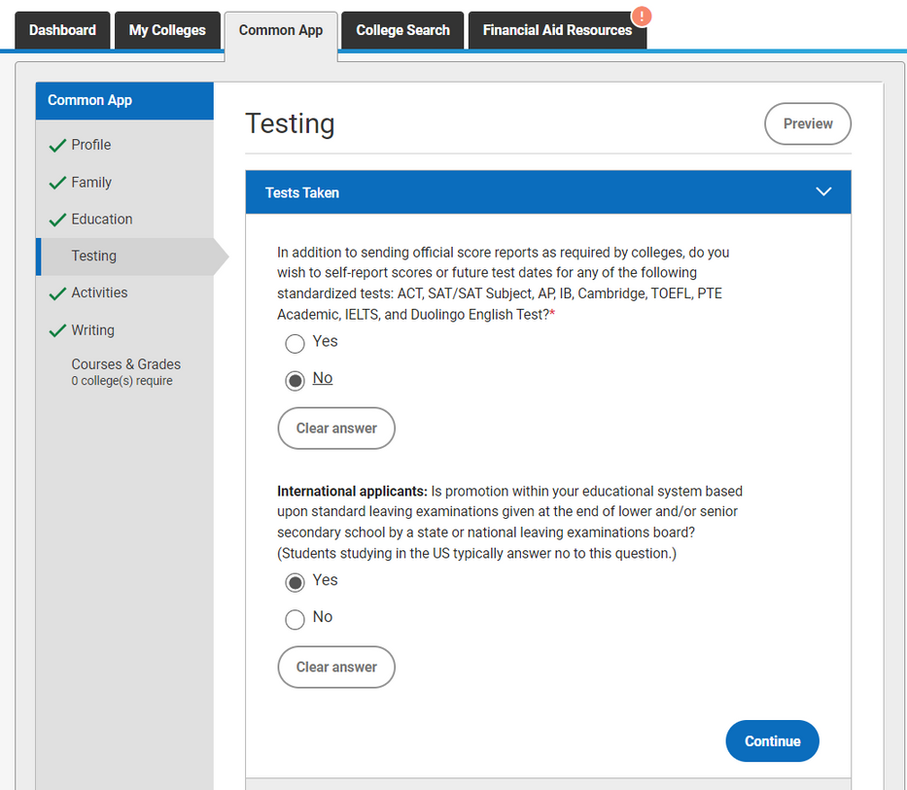
COMMON APP
YOUR
Testing
01
Select "Yes" if planning to take or have taken SATs/ACTs/Duolingo/ IELTS/TOEFLS etc. A section will appear where you can self-report your scores
Is promotion based on standard leaving exams given by a national examination board? - Yes
03

Slide 13
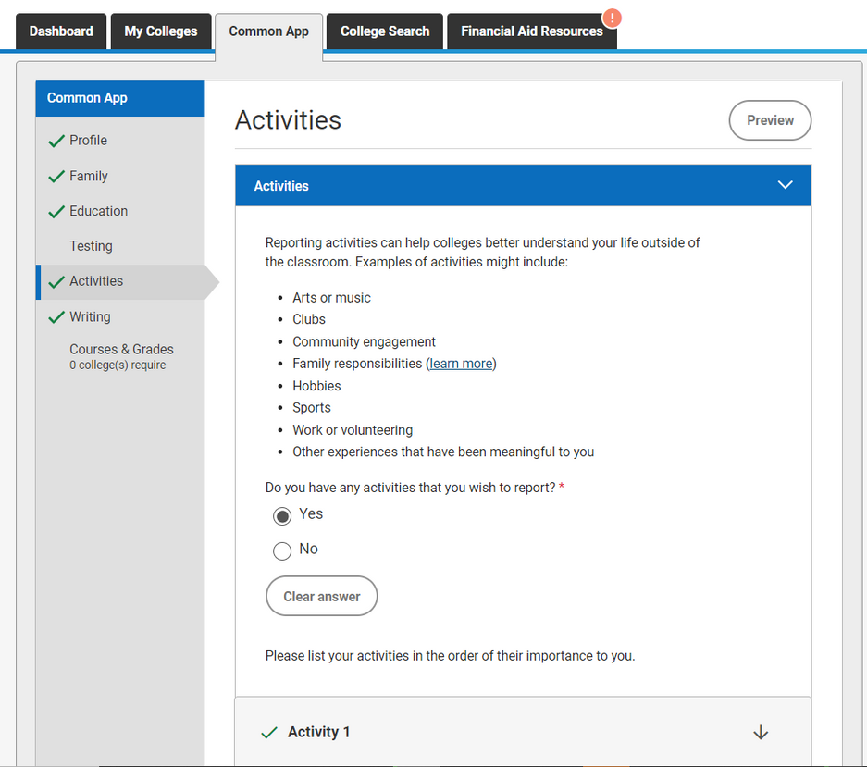

COMMON APP
YOUR
Activities
01
Do not leave this section blank
List impactful activities you took part in during and after high school - clubs, leadership, volunteering
02
03
Give a short description of the activity - 150 characters max.
Approximate the number of hours per week and weeks per year you spent on each activity. Don't exaggerate
04
Use action verbs & descriptive phrases - championed, improved, raised x amount...

Slide 14
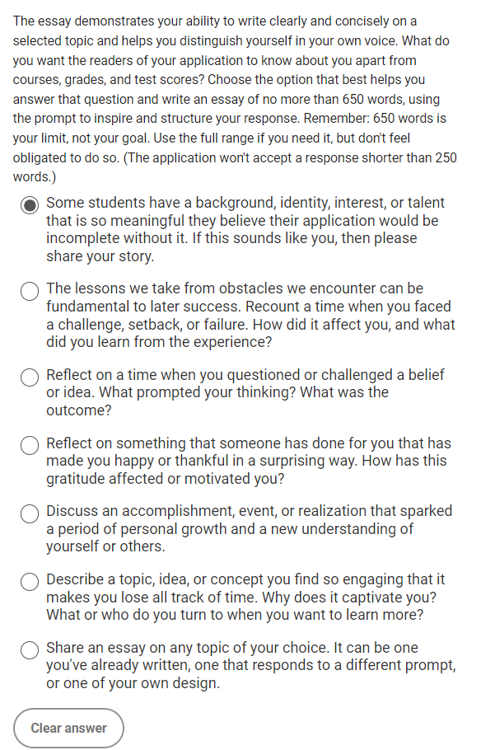
COMMON APP
YOUR
Writing
01
One of the most important parts of your application
Choose one of the 7 prompts for your personal statement. 650 words max.
02
Use the Additional Information section to share anything you feel the Admissions Committee may need to know/fill gaps in your application
03
Use the Community Disruptions essay to explain any effects that disasters e.g. drought/floods or COVID-19 has had on you.
04

Slide 15
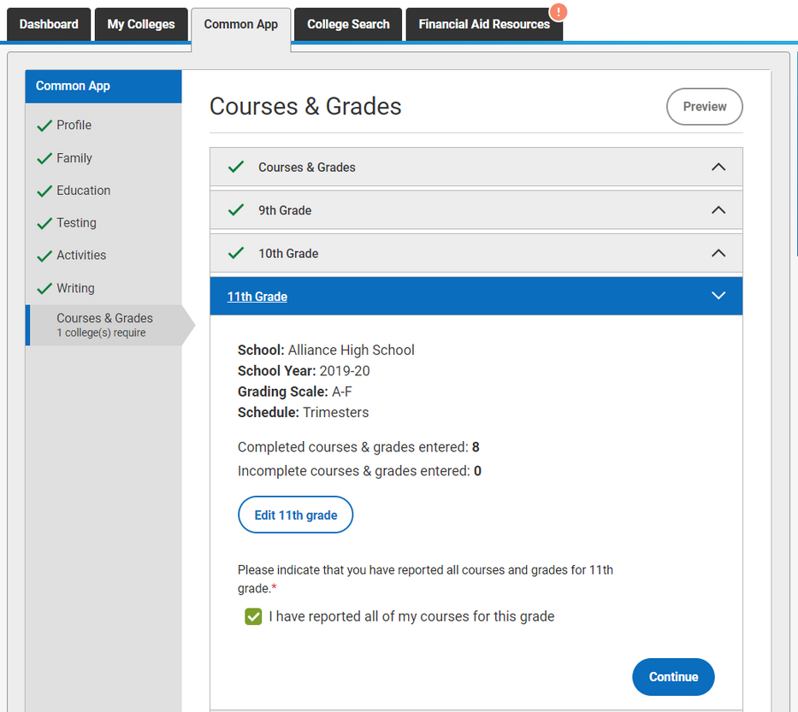
COMMON APP
YOUR
Courses & Grades
01
Not all universities require this section
If required, fill out all courses you took since 9th grade/form 1.
02
Only provide grades that are in your transcript e.g if transcript does not have termly grades, only fill final grades
03

Slide 16

COMMON APP
YOUR
Leave out your enrolment in Kenyan Universities
Use an external word processor such as MS Word or Google Docs to write your essays.
Install the Grammarly extension on your PC or Grammarly Keyboard on your phone.
You can provide meanings of abbreviations you have used in your essays in the additional info section.

Slide 17


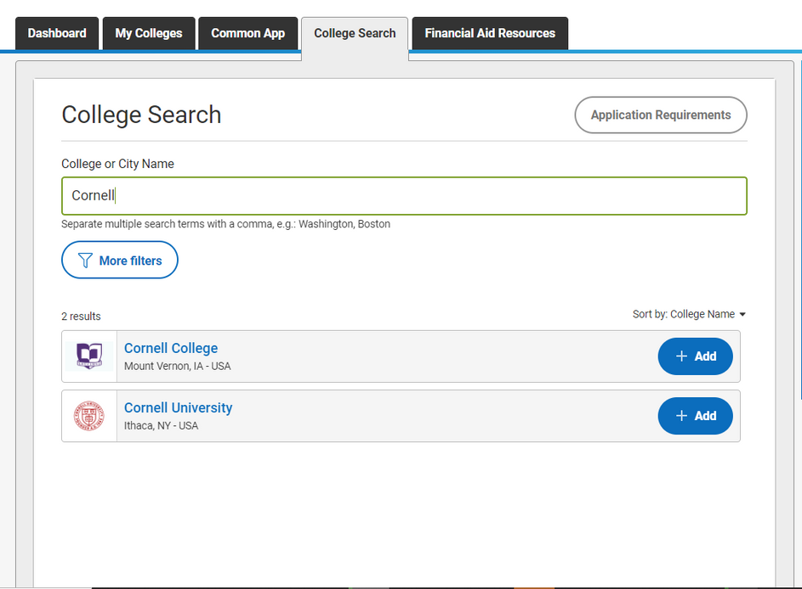
College Search
Adding Colleges to your List
Go to the "College Search" tab
Enter the name of the college/university in the search bar.
Click "+ Add" beside the name of your desired institution.
Done! You can now access the added college in the dashboard or "My Colleges" tab.

Slide 18
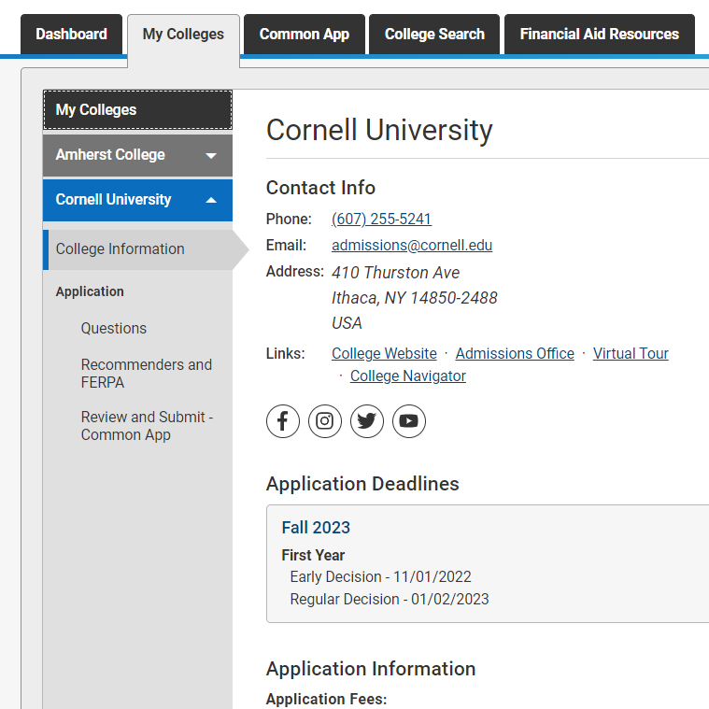
My Colleges Tab
Here, you will find more info specific to each university under the "College Information" subsection. These include decision plans and their deadlines, contact info, testing policies, etc.
Application
Here, you will answer questions specific to each school e.g Supplementary essays
Some schools will have the option to upload a resume here
Some schools will have the option to upload a resume here
Writing Supplement
Supplementary essays will most often be under this section.

Slide 19
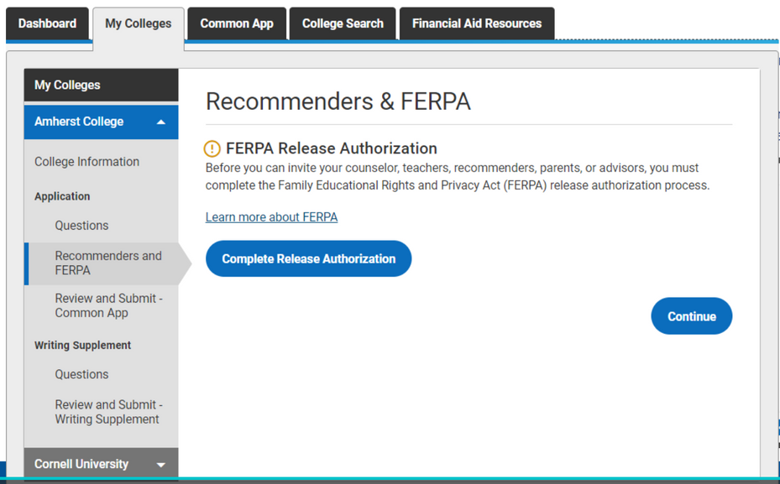
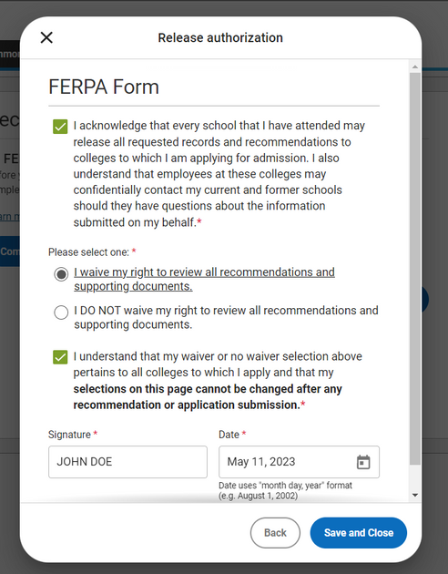

Recommenders and FERPA
This section lets you invite recommenders, appoint a counsellor, and invite parents to sign ED contracts.
Waive your right to view your recommendations by coompleting the FERPA release authorisation form
Add your mentor as an advisor.
Advisors can view your application

Slide 20
TIPS
MORE
Do not include petty punishments when asked about your disciplinary records
Familial responsibilities and house chores are considered activities
You can use Equity Head Office's address as your address:
8 th Floor Equity Centre Upperhill, Nairobi 00200

Slide 21







Questions, anyone?

